Slide 1
Computer Architecture and organization M.Nivedita Assistant Professor SCOPE VIT Chennai

Slide 2
Books
David A. Patterson and John L. Hennessy, Computer Organization and Design -The Hardware / Software Interface 6th Edition, Morgan Kaufmann, 2020.
Computer Architecture and Organization-Designing for Performance, William Stallings, Tenth edition, Pearson Education series, 2016 .
Carl Hamacher, Zvonko Vranesic, Safwat Zaky, Computer organization, Mc Graw Hill, Fifth edition, Reprint 2011.

Slide 3
Assesment
CAT – I - 15
CAT – II - 15
Digital ASSIGNMENT - 30
Term End Exam - 40

Slide 4
Objective
How computers work, basic principles.
How to analyze their performance.
How computers are designed and built.
To teach arithmetic of computers.
To provide knowledge of memory technologies, interfacing techniques and subsystem devices and the issues in that.

Slide 5
Motivation
This knowledge will be useful if you need to
Design/build a new version of a computer
Improve software performance
Purchase a computer
Provide a solution with an embedded computer

Slide 6
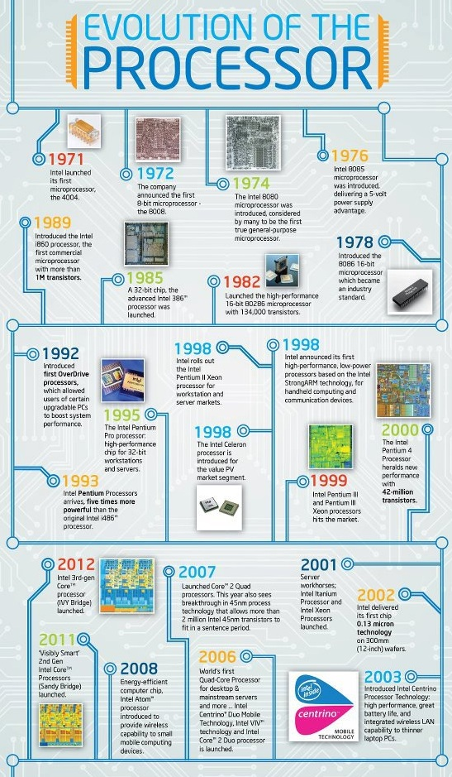

Slide 7
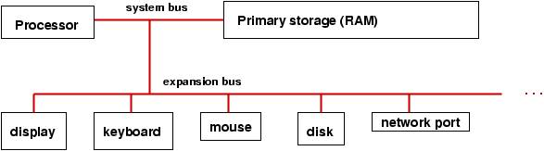
What is computer architecture?
Computer architecture deals with the functionality of every hardware unit of a CPU. i.e. what a specific hardware unit works in a computer
Computer architecture is a specification detailing how a set of software and hardware technology standards interact to form a computer system or platform.

Slide 8
What is computer Organization?
Computer organization deals with the implementation of every hardware unit of a CPU. i.e. how a specific hardware unit works in a computer
It refers to the operational units of the hardware device and interconnections between various hardware devices realize the architectural specifications.

Slide 9
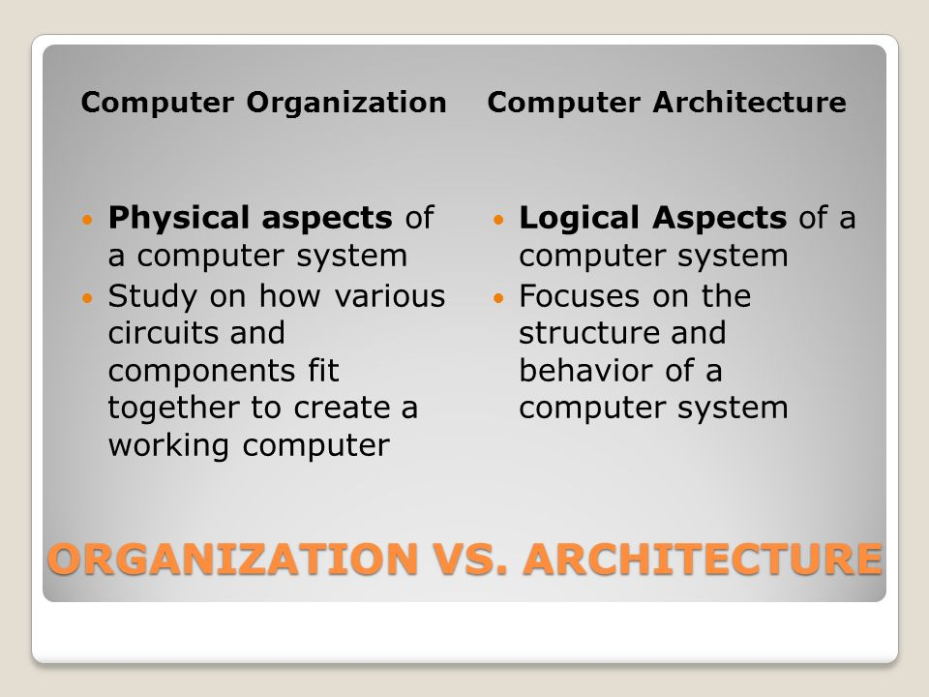

Slide 10
All Intel x86 family will share the same basic architecture.
The IBM System/370 family will share the same basic architecture.
This helps to enable code compatibility.(backwards)
But organisation is different for different versions.

Slide 11
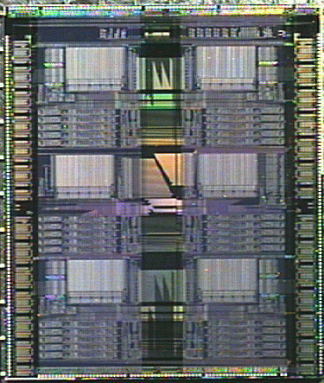


Interfaces
Technology
API
ISA
Link
I/O Chan
Machine Organization
IR
Regs
Applications
Measurement &
Evaluation
Computer Architect

Slide 12
Structure and Function
Structure is the way in which components relate to each other.
Function is the operation of individual components as part of the structure. The computer functions are,
Data processing
Data storage
Data movement
Control

Slide 13
Functional View
Operating Environment (Source, Destination of Data)
Data Movement
apparatus
Control Mechanism
Data Processing Facility
Data Storage
Facility

Slide 14
Data Movement
movement
control
Storage
Processing

Slide 15
Storage
Movement
Control
Storage
Process

Slide 16
Processing from/to storage
Movement
Control
Storage
Process

Slide 17
Processing from storage to I/O
Movement
Control
Storage
Process

Slide 18
Structure
Storage
Processing
Computer
Communication Lines
Peripherals

Slide 19
Structure - Top Level
Peripherals
Computer
Central
Processing
Unit
Main
Memory
Computer
Systems
Interconnection
Input
Output
Communication
lines

Slide 20
Structure - The CPU
CPU
Computer
Arithmetic
and
Login Unit
I/O
Registers
System
Bus
CPU
Internal CPU
Interconnection
Memory
Control
Unit

Slide 21
Structure - The Control Unit
Control Unit
CPU
ALU
Sequencing
Login
Internal
Bus
Control
Unit
Control Unit
Registers and
Decoders
Registers
Control
Memory

Slide 22
Structural components
CPU – Processor
Main Memory – Stores data
I/O – Moves the data
System Interconnection
Control Unit – controls operation
ALU – data processing
Registers – storage internal to CPU
CPU Interconnection

Slide 23
ENIAC
ENIAC (Electronic Numerical Integrator And Computer)
1st general-purpose electronic digital computer.
Designed by John Mauchly and John Presper Eckert at University of pennsylvania.
Funded by US BRL (Ballistic Research Lab) to develop range and trajectory tables for new weapons
Until then, BRL employeed more than 200 people who, using desktop calculators to solve the necessary ballistics equations
The proposal accepted in 1943, the machine completed in 1946, and dismantled in 1955
Characteristics
30 tons, 15000 square feet, 18000 vacuum tubes, 140 KW power dissipation
Decimal machine
20 accumulators each holding 10-digit decimal number
Each digit is represented by a ring of 10 vacuum tubes
5,000 additions per second
Manually programmed by setting switches and plugging/unplugging cables

Slide 24
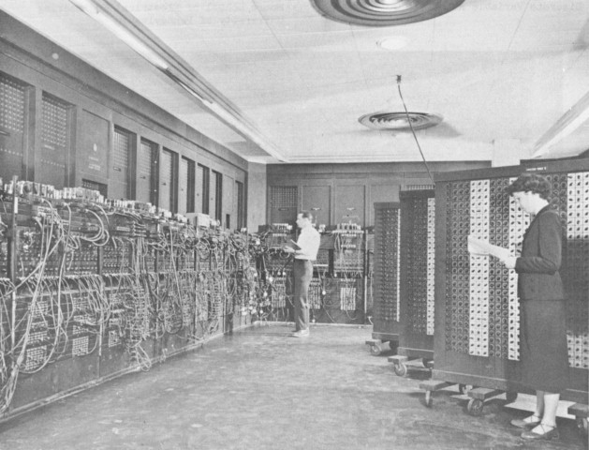
ENIAC

Slide 25
Von Neumann Machine
The task of entering and altering programs for the ENIAC was extremely tedious.
The programming process could be facilitated if the program could be represented in a form suitable for storing in memory alongside the data.
Then, a computer could get its instructions by reading them from memory, and a program could be set or altered by setting the values of a portion of memory.

Slide 26
The Stored Program Concept
Von Neumann’s proposal was to store the program instructions right along with the data
The stored program concept was proposed about fifty years ago; to this day, it is the fundamental architecture that fuels computers.

Slide 27
von Neumann/Turing
Stored Program concept
Main memory storing instructions and data
ALU operating on binary data
Control unit interpreting instructions from memory and executing
Input and output equipment operated by control unit
Princeton Institute for Advanced Studies
IAS
Completed 1952

Slide 28
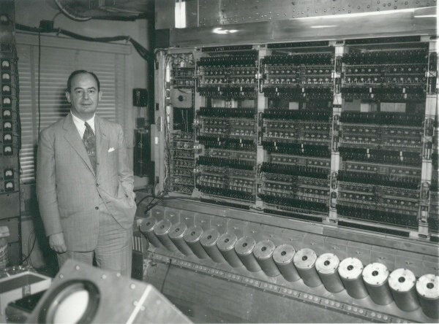
The Von Neumann Machine & IAS

Slide 29
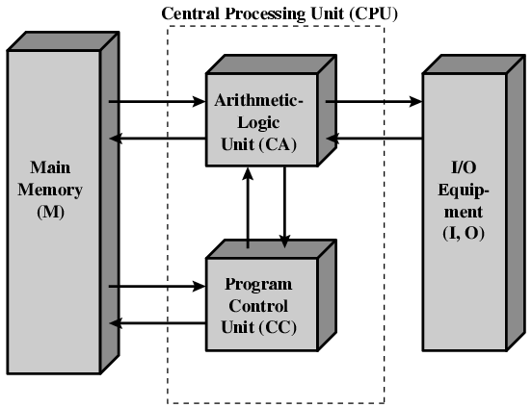
Structure of IAS Computer

Slide 30
The Stored Program Concept and its Implications
The Stored Program concept had several technical ramifications:
Four key sub-components operate together to make the stored program concept work
The process that moves information through the sub-components is called the “fetch execute” cycle
Unless otherwise indicated, program instructions are executed in sequential order

Slide 31
Four Sub-Components
There are four sub-components in von Neumann architecture:
Memory
Input/Output (called “IO”)
Arithmetic-Logic Unit
Control Unit
While only 4 sub-components are called out, there is a 5th, key player in this operation: a bus, or wire, that connects the components together and over which data flows from one sub-component to another
Let’s look at each sub-component in more detail …

Slide 32
Memory
As you already know, there are several different flavors of memory
Each type of memory represents cost/benefit tradeoffs between capability and cost .

Slide 33
Memory Types: RAM
RAM is typically volatile memory (meaning it doesn’t retain voltage settings once power is removed)
RAM is an array of cells, each with a unique address
A cell is the minimum unit of access. Originally, this was 8 bits taken together as a byte. In today’s computer, word-sized cells (16 bits, grouped in 4) are more typical.
RAM gets its name from its access performance. In RAM memory, theoretically, it would take the same amount of time to access any memory cell, regardless of its location with the memory bank (“random” access).

Slide 34
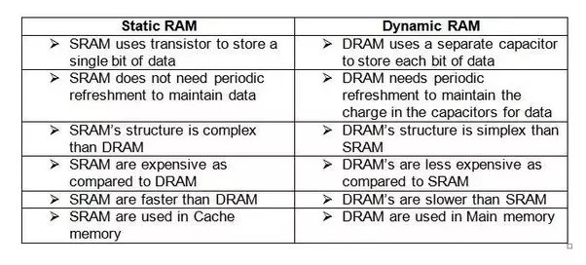

Slide 35
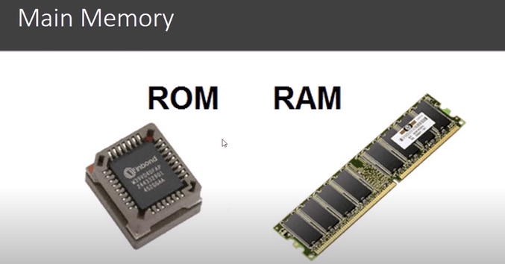
Memory Types: ROM
It gets its name from its cell-protection feature. This type of memory cell can be read from, but not written to.
Unlike RAM, ROM is non-volatile; it retains its settings after power is removed.
ROM is more expensive than RAM, and to protect this investment, you only store critical information in ROM …

Slide 36
ROM (Read Only Memory)
Types of ROM:
Programmable ROM, where the data is written after the memory chip has been created. It is non-volatile.
Erasable Programmable ROM, where the data on this non-volatile memory chip can be erased by exposing it to high-intensity UV light.
Electrically Erasable Programmable ROM, where the data on this non-volatile memory chip can be electrically erased using field electron emission.

Slide 37
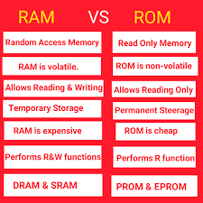

Slide 38
Memory Types: Registers
There is a third, key type of memory in every computer – registers.
Register cells are powerful, costly, and physically located close to the heart of computing.
Registers are the main participants in the fetch execute cycle.

Slide 39
Memory Types: Other
Modern computers include other forms of memory, such as cache memory.
Remember, memory types exist at different trade offs.

Slide 40
I/O: Input and Output
There is both a human-machine interface and a machine-machine interface to I/O.
Examples of the human-machine interface include a keyboard, screen or printer.
Examples of the machine-machine interface include things like mass storage and secondary storage devices.
Input and output devices are the least standardized of the various sub-components, which means that you have to pay extra special attention to make certain that your input or output devices are compatible with your machine.

Slide 41
The ALU
The third component in the von Neumann architecture is called the Arithmetic Logic Unit.
This is the subcomponent that performs the arithmetic and logic operations for which we have been building parts.
The ALU is the “brain” of the computer.
It contains the circuitry to perform addition, subtraction, multiplication and division, as well as logical comparisons (less than, equal to and greater than).

Slide 42
Control Unit
The last of the four subcomponents is the Control Unit.
The control unit drives the fetch and execute cycle.
Controls which address is loaded into the memory and what operation is taking place in the data.

Slide 43
IAS - details
The memory of the IAS consists of 1000 storage locations, called words, of 40 binary digits each.
Both data and instructions are stored there.
Each number is represented by a sign bit and a 39-bit value.
A word may also contain two 20-bit instructions, with each instruction consisting of an 8-bit operation code specifying the operation to be performed and 12-bit address designating one of the words in memory.

Slide 44
IAS Memory Formats
NUMBER WORD
0
1
39
Sign Bit

Slide 45
Instruction Word
Left Instruction
Right Instruction
0
8
20
28
39
Opcode
Opcode
Address
Address

Slide 46
Set of registers (storage in CPU)
Memory Buffer Register
Memory Address Register
Instruction Register
Instruction Buffer Register
Program Counter
Accumulator
Multiplier Quotient

Slide 47
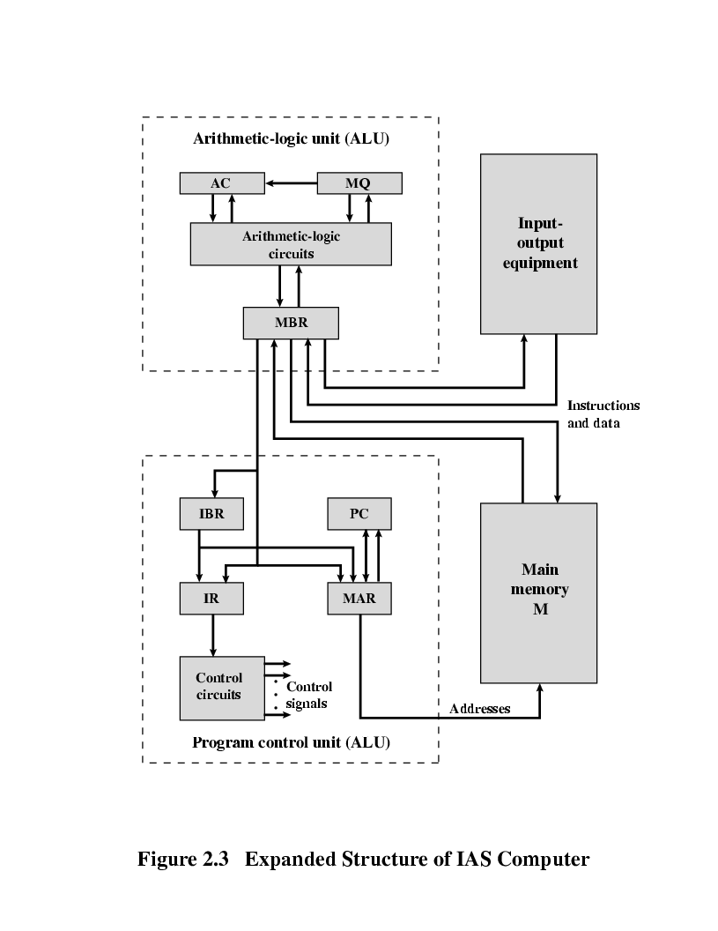
Expanded Structure of IAS Computer

Slide 48
Registers
MBR – Memory Buffer Register contains a word to be stored in memory or sent to the I/O unit or is used to receive a word from memory.
MAR – Memory Address Register specifies the address of the word to be written from MBR, to be read into MBR.
Instruction Register (IR) - 8 bit opcode instruction being executed.
Instruction Buffer Register (IBR)– hold the right hand instruction from a word in memory.
Program Counter(PC) – address of the next instruction pair fetched from memory.

Slide 49
Contd.,
Accumulator (AC) , Multiplier Quotient (MQ)
temporarily hold operands and the results of
ALU operations
Example:
40 bit multiply operation
Most Significant Bit - AC
Least Significant Bit - MQ

Slide 50
CONTD.,
IAS – Instruction Cycle
Subcycles
→ Fetch cycle
→ Execute cycle
Fetch cycle
Opcode of next instruction is loaded in IR
Address portion is loaded in MAR
Instruction taken from IBR or can be obtained from memory (MBR)

Slide 51
Contd.,
Execute cycle
Once the opcode is in IR the execute cycle is performed
Control circuitry interprets the opcode and executes instruction by sending out control signals, which allows Data movement or operation to be performed by ALU.

Slide 52
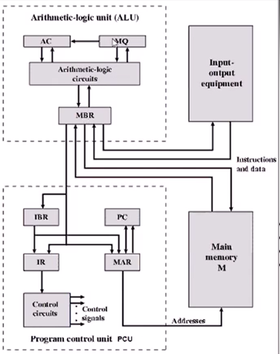
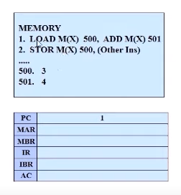
LOAD M(X),500
ADD M(X),501
=1
LOAD M(X),500
ADD M(X),501
=1
=1
EXAMPLE

Slide 53
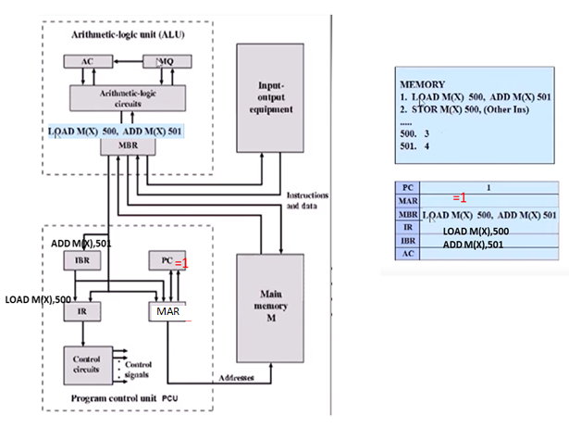
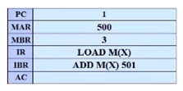
=3
MBR=3
3
3
500
500
EXAMPLE

Slide 54
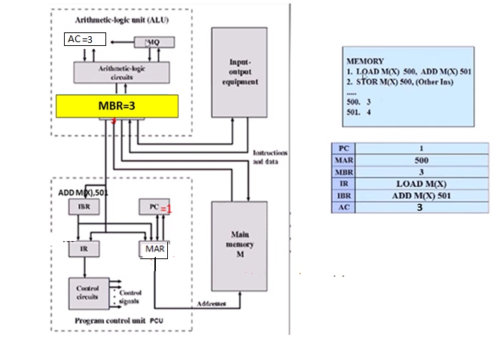
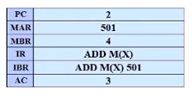
MBR =4
4
PC=2
ADD M(X)
501
501
EXAMPLE

Slide 55
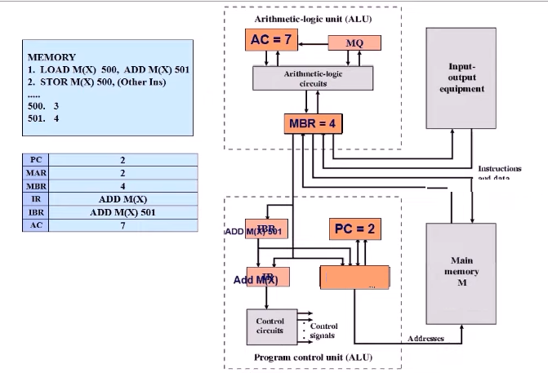
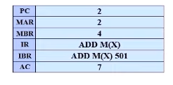
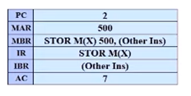
STOR M(X),500
Other Ins
STOR M(X) 500, (Other Ins)
MAR = 2
2
EXAMPLE

Slide 56
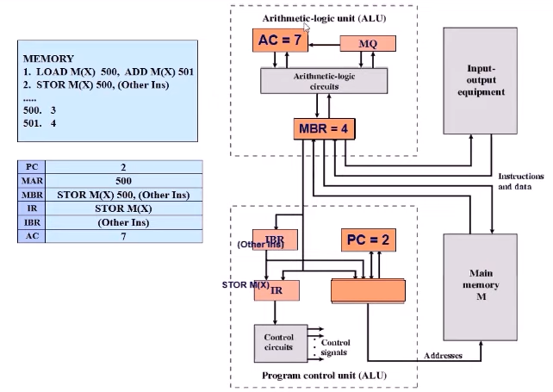
MAR = 500
500
7
EXAMPLE

Slide 57
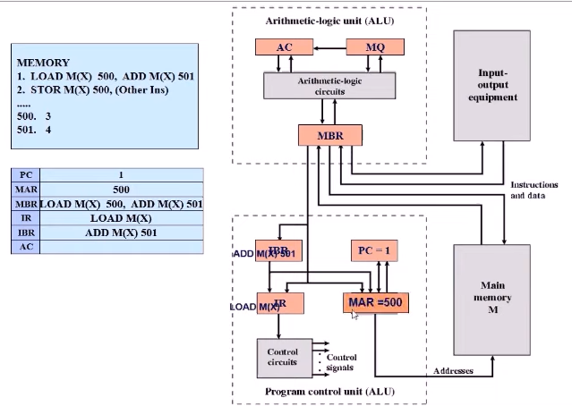

Slide 58
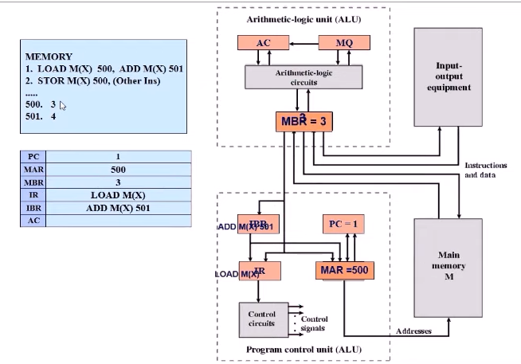

Slide 59
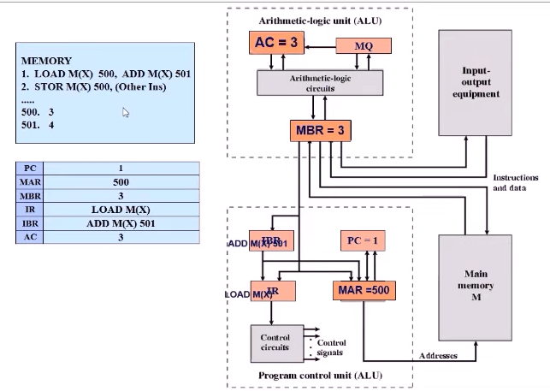

Slide 60
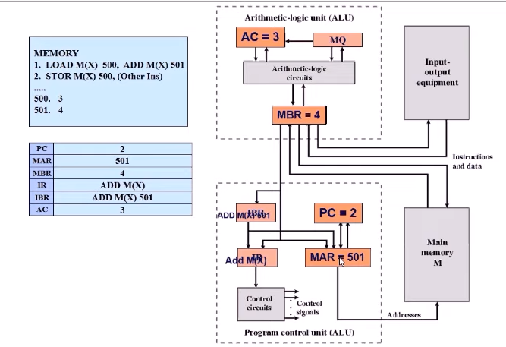

Slide 61
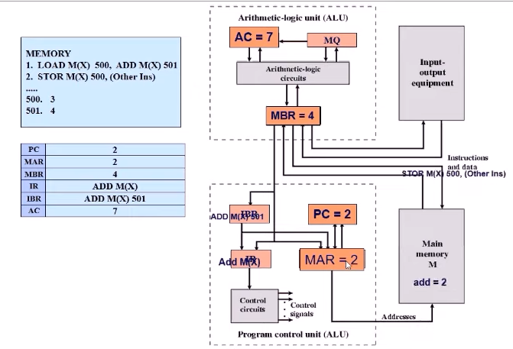

Slide 62
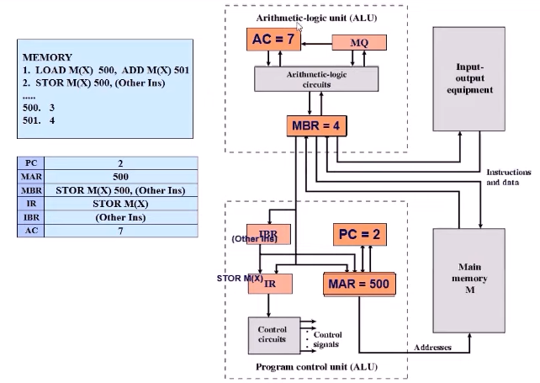

Slide 63
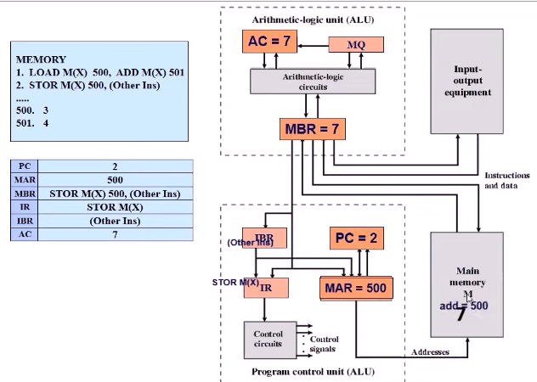

Slide 64
IAS Instruction Set
Data Transfer – moves the data between Memory and ALU
registers or between two ALU registers
Unconditional Branch – CU executes instructions in sequence from memory, sequence can be changed by branch instructions (repetitive operations)
Conditional Branch – branch can be made dependent on condition.
Arithmetic – operations performed by ALU
Address modify – permits the address to be computed in the ALU and then inserted into instructions stored in memory.

Slide 65
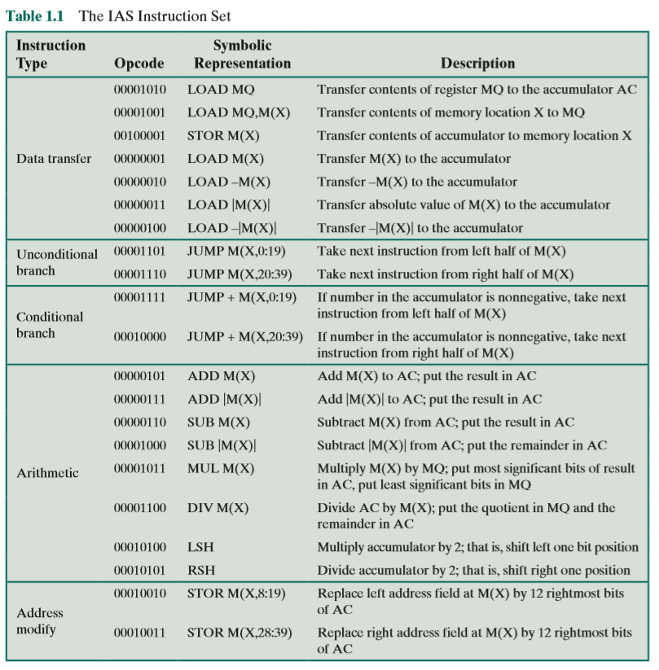

Slide 66
Harvard Architecture
Finished at Harvard University in 1947.
It wasn't so modern as the computer from von Neumann team. But it introduced a slightly different architecture.
Memory for data was separated from the memory for instruction. This concept is known as the Harvard architecture.

Slide 67
Diagrammatic view of Harvard Architecture

Slide 68
Advantages of Harvard
since it has two memories , this allows parallel access to data and instructions.
Development of the Control Unit is expensive and needs more time
Data and instructions are accessed the same way.
Both memories can use different cell sizes.

Slide 69
Disadvantages of Harvard
Free data memory cant be used for instruction and vice-versa.
Production of a computer with two buses is more expensive and needs more time.

Slide 70
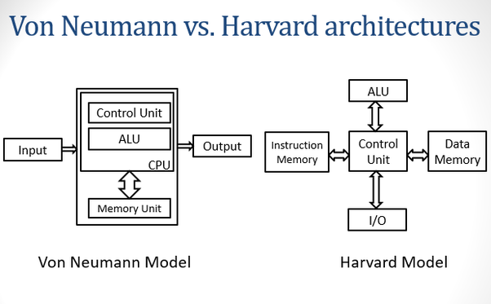

Slide 71
Harvard vs von Neumann
Harvard
Von Neumann
Two memories with two Buses allow parallel access to data access and instructions.
Control unit for two buses is more complicated and more expensive.
Both memories can use different sizes.
Content of the memory if organised and all installed memory can be used.
One bus is simpler for the control unit design
Computer with one bus is cheaper.

Slide 72
Harvard vs von Neumann
Harvard
Von Neumann
Development of a complicated Control Unit needs more time.
Free data memory can’t be used for instruction and vice-versa.
Development of the Control Unit is cheaper and faster.
Data and instruction is accessed in the same way.
One Bus ( for Data, instruction and devices) is a bottleneck.

Slide 73
RISC and CISC Architectures

Slide 74
RISC (Reduced Instruction Set Computer)
A Reduced Instruction Set Computer is a type of microprocessor architecture that utilizes a small, highly-optimized set of instructions rather than the highly-specialized set of instructions typically found in other architectures.
Examples of RISC processors: IBM RS6000, MC88100; DEC’s Alpha 21064, 21164 and 21264 processors
It is a highly customized set of instructions used in portable devices due to system reliability such as Apple iPod, mobiles/smartphones, Nintendo DS

Slide 75
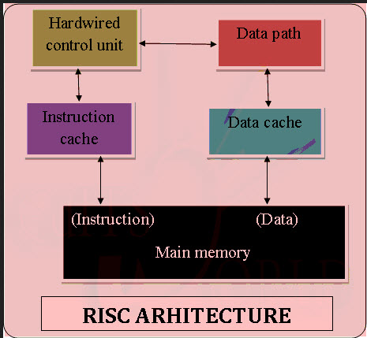
RISC Features
RISC processors use a small and limited number of instructions.
RISC machines mostly uses hardwired control unit.
RISC processors consume less power and are having high performance.
Each instruction is very simple and consistent.
RISC processors uses simple addressing modes.
RISC instruction is of uniform fixed length.

Slide 76
CISC (Complex Instruction Set Computer)
A complex instruction set computer (CISC) is a computer architecture in which single instructions can execute several low-level operations (such as a load from memory, an arithmetic operation, and a memory store) or are capable of multi-step operations or addressing modes within single instructions.
Examples of CISC processors are: Intel 386, 486, Pentium, Pentium Pro, Pentium II, Pentium III ; Motorola’s 68000, 68020, 68040, etc.
It has a large collection of complex instructions that range from simple to very complex and specialized in the assembly language level, which takes a long time to execute the instructions.

Slide 77
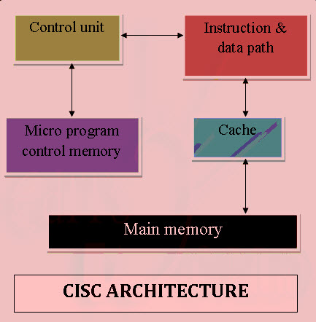
CISC Feature
CISC chips have a large amount of different and complex instructions.
CISC machines generally make use of complex addressing modes.
Different machine programs can be executed on CISC machine.
CISC machines uses micro-program control unit.
CISC processors are having limited number of registers.

Slide 78
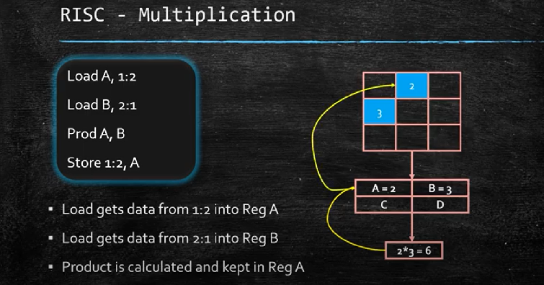
CISC Multiplication
MULT 1:2,2:1

Slide 79
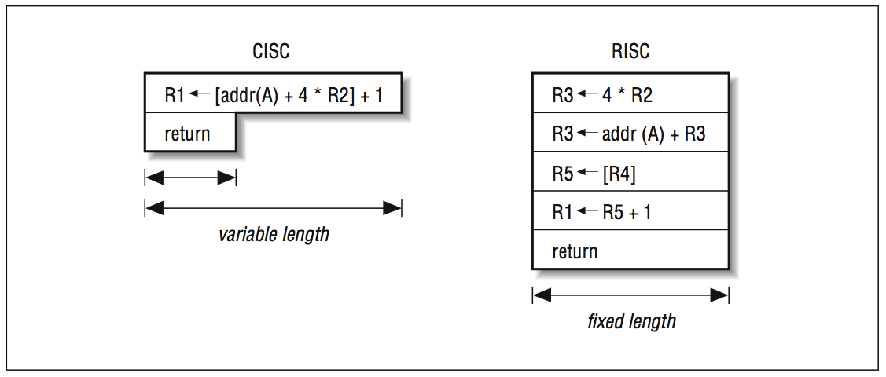
CISC vs RISC
CISC uses a large set of complex machine language instructions, while RISC uses a reduced set of simpler instructions
The primary difference between RISC and CISC architecture is that RISC-based machines execute one instruction per clock cycle. In a CISC processor, each instruction performs so many actions that it takes several clock cycles to complete.

Slide 80
